Slide 1
CS 35L Software Construction Lab Week 3 – Modifying and Rewriting Software

Slide 2
How to Install Software
Linux
rpm (Redhat Package Management)
RedHat Linux (.rpm)
apt-get (Advanced Package Tool)
Debian Linux, Ubuntu Linux (.deb)
Good old build process
configure, make, make install

Slide 3
Decompressing Files
Generally, you receive Linux software in the tarball format (.tgz) or (.gz)
Decompress file in current directory:
$ tar –xzvf filename.tar.gz
Option –x: --extract
Option –z: --gzip
Option –v: --verbose
Option –f: --file

Slide 4
Build Process
configure
Script that checks details about the machine before installation
Dependency between packages
Creates ‘Makefile’
make
Requires ‘Makefile’ to run
Compiles all the program code and creates executables in current temporary directory
make install
make utility searches for a label named install within the Makefile, and executes only that section of it
executables are copied into the final directories (system directories)

Slide 5
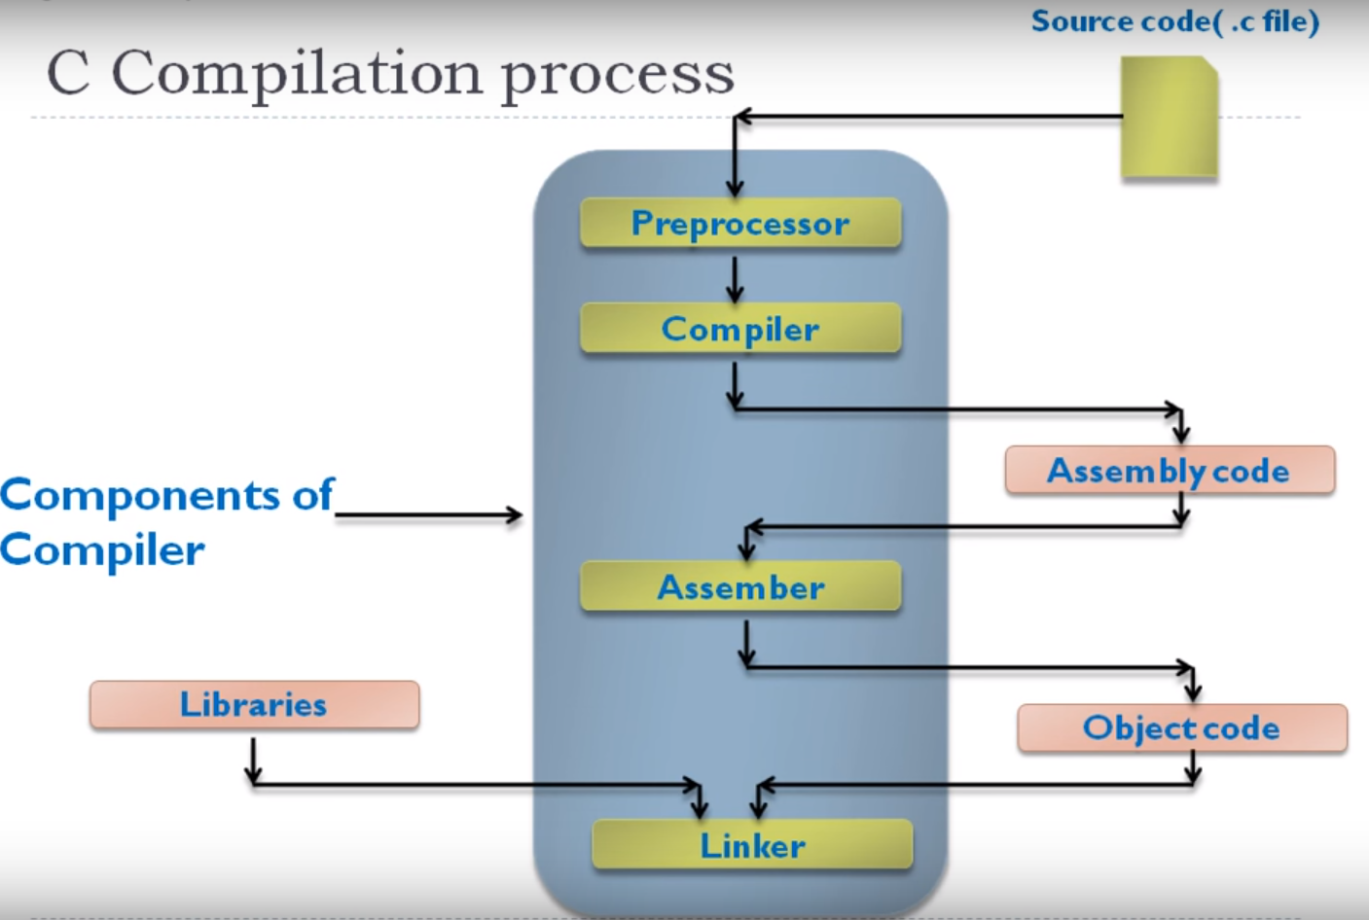
GCC Compilation Process

Slide 6
GCC compilation …
Preprocessor:
Removes comments from code
Includes header files code in the file itself
Replaces macro name (small functions) with values #define x 6 => this value replaced into file
Compiler
Generate assembly code
Assembler
Converts assembly code to machine code (binary) - object code)
Linker:
Used when we have multiple modules
We need a single executable file, linker is used to combine all files
Links library functions

Slide 7
Command-Line Compilation
item.h
item.c
#includes item.h
shoppingList.h
#includes item.h
shoppingList.c
#includes shoppingList.h
shop.h
shop.c
#includes shoppingList.h and shop.h
How to compile?
gcc -Wall shoppingList.c item.c shop.c –o shop

Slide 8
Expanding the command
gcc - compiler program
-Wall - turn all warnings on
-o - to name the executable as the name given, instead of a.out

Slide 9
What if…
We change one of the header or source files?
Rerun command to generate new executable
We only made a small change to item.c?
not efficient to recompile shoppinglist.c and shop.c
Solution: avoid waste by producing a separate object code file for each source file
gcc -Wall –c item.c… (for each source file)
Wall: This enables all the warnings about constructions
gcc item.o shoppingList.o shop.o –o shop (combine)
Less work for compiler, saves time but more commands

Slide 10
What if…
We change item.h?
Need to recompile every source file that includes it & every source file that includes a header that includes it. Here: item.c, shoppinglist.c and shop.c
Difficult to keep track of files when project is large
Windows 7 ~40 million lines of code
=> Make

Slide 11
Make
Utility for managing large software projects
Compiles files and keeps them up-to-date
Efficient Compilation (only files that need to be recompiled)

Slide 12
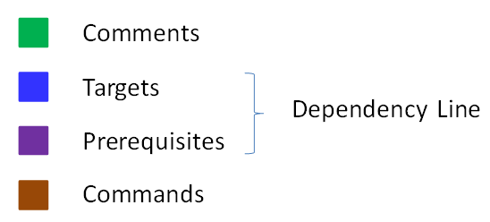
Makefile Example
# Makefile - A Basic Example – only executes changed files
all : shop #usually first #all is called the target and so are shop, item.o…., clean
shop : item.o shoppingList.o shop.o #dependencies
gcc -Wall -o shop item.o shoppingList.o shop.o
item.o : item.cpp item.h
gcc -Wall -c item.cpp
shoppingList.o : shoppingList.cpp shoppingList.h
gcc -Wall -c shoppingList.cpp
shop.o : shop.cpp item.h shoppingList.h
gcc -Wall -c shop.cpp
clean :
rm -f item.o shoppingList.o shop.o shop
Example Bash command: ‘make shop’ will execute
gcc -Wall -o shop item.o shoppingList.o shop.o
Rule

Slide 13
Is the order of rules important?
Not significant, except for determining the Default goal: the target for make to consider, if you do not otherwise specify one
Default goal: target of the first rule in the makefile
First rule is the one for compiling the entire program or all the programs described by the makefile (often with a target called `all')

Slide 14
Basics
Variable declaration
Flags= -c –Wall
Compiler=g++
Bash command ‘make <word>’ executes the target
Example, make clean would execute whatever’s below the target ‘clean’

Slide 15
Task
You have a main target ‘hello’ (all : hello) which should execute all object files main.o function1.o function2.o and combine them into ‘hello’
Each .o file should be created by compiling the cpp files individually (in a separate line)
You have 3 cpp files - main.cpp function1.cpp function2.cpp
Need to compile these files using Makefile
In the end, write clean to remove all executables and object files
Notes:
https://www.youtube.com/watch?v=aw9wHbFTnAQ

Slide 16
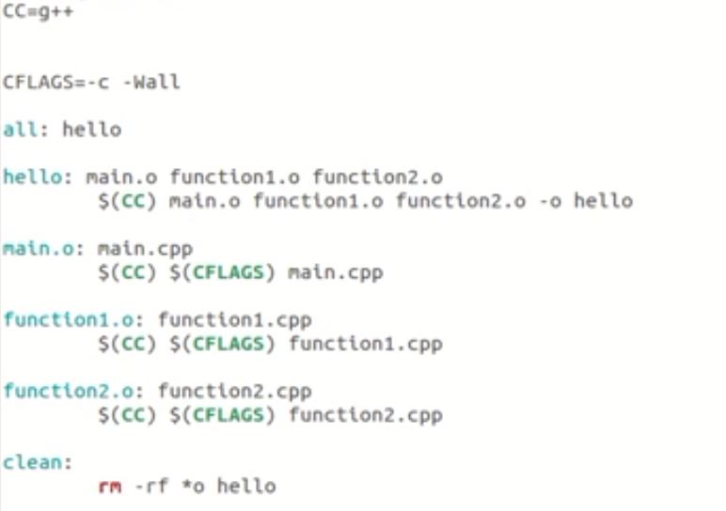
Solution

Slide 17
Lab 3
Coreutils 8.29 has a problem
Flags –a and –A override issue.
$ ls –a –A : -a overrides –A. should be vice-versa
Why?
With –A, ‘.’ and ‘..’ should not be listed
Fix the ls program

Slide 18
Getting Set Up (Step 1)
Download coreutils and key file to your home directory
Use ‘wget’
Untar and Unzip it
tar –xf coreutils-8.29.tar.xz
Make a directory coreutilsInstall (this is where you’ll be ‘installing’ coreutils)
mkdir coreutilsInstall inside coreutils-8.29 (can use this for prefix)

Slide 19
Building coreutils (Step 2)
Go into coreutils-8.29 directory. This is what you just unzipped.
Read the INSTALL file on how to configure “make”, especially --prefix flag
./configure –prefix=$pwd/coreutilsInstall
Run the configure script using the prefix flag so that when everything is done, coreutils will be installed in the directory coreutilsInstall
Compile it: make
Install it: make install

Slide 20
structure
Untarred folder coreutils-8.29
Has src folder
Since the patch file uses src/ls.c we modify the ls program using the patch here
Test src/ls –aA to see behavior
CoreutilsInstall inside coreutils-8.29
Prefixed version
Test ./bin/ls –aA to see behavior

Slide 21
Reproduce Bug (Step 3)
Reproduce the bug by running the version of ‘ls’ in coreutils-8.29 directory
If you just type $ ls at CLI it won’t run ‘ls’ in coreutils-8.29 directory
Why? Shell looks for /bin/ls
Now:
cd coreutilsInstall
./bin/ls -aA
This manually runs the executable in this directory

Slide 22
Patching
A patch is a piece of software designed to fix problems with or update a computer program
It’s a diff file that includes the changes made to a file
A person who has the original (buggy) file can use the patch command with the diff file to add the changes to their original file

Slide 23
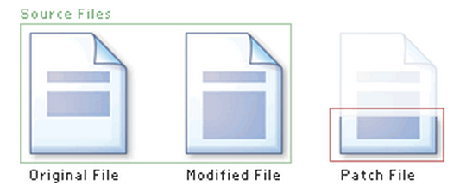
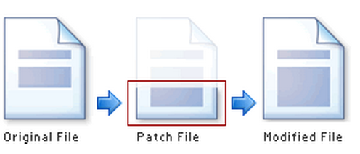
Applying a Patch

Slide 24
diff Unified Format
diff –u original_file modified_file
--- path/to/original_file
+++ path/to/modified_file
@@ -l,s +l,s @@
@@: beginning of a hunk
l: beginning line number
s: number of lines the change hunk applies to for each file
A line with a:
- sign was deleted from the original
+ sign was added to the original
stayed the same

Slide 25
Patching and Building (Steps 4 & 5)
cd coreutils-8.29 directory
vim patch_file: copy and paste the patch content
patch –pnum < patch_file
‘man patch’ to find out what pnum does and how to use it
type make to rebuild patched ls.c in src folder. No make install
This is the folder where you will patch in src/ls

Slide 26
Testing Fix (Step 6)
Observe: first few entries have . and ..
In patched folder
./ls -a produces . and ..
./ls -aA does not produce the . and ..
In unmodified folder
./ls -aA produces . And ..

Slide 27
Steps
wget <whatever>
tar -xvzf <tar file>
mkdir coreutils <- dir
cd <untared file>
./configure --prefix=absolute path to dir
make
make install
cd dir
./bin/ls -l <- reproduces bug (unmodified file)
cd <untared file>
make a patch file from that link patch_file
patch -p1 < patch_file
Make
./bin/ls -l

Slide 28
Homework 3
shuf.py

Slide 29
Homework 3
shuf.py – this should end up working almost exactly like the utility ‘shuf’
Check $ man shuf for extensive documentation
Extra options
--input-range (-i): shuf -i 1-4
--head-count (-n): shuf –n 4 -i 0-9
--repeat (-r): shuf –r -n 20 -i 0-9
--help: usage documentation.

Slide 30
Homework 3
Use randline.py as a starting point!
Modify to accomplish logical task of shuf
Shuf C source code :
Shuf C source code - sample
This will give you an idea of the logic behind the operation that shuf executes

Slide 31
Randline.py
Run it
./randline.py –n 3 filename (need execute permission)
python randline.py –n 3 filename (no execute permission)
randline.py has 3 command-line arguments:
n: specifies the number of lines to write
option
3: number of lines
option argument to n
filename: file to choose lines from
argument to script
Output: 3 random lines from the input file
Python 3 is installed in /usr/local/cs/bin
export PATH=/usr/local/cs/bin:$PATH

Slide 32
Python Walk-Through
#!/usr/bin/python
import random, sys
from optparse import OptionParser
class randline:
def __init__(self, filename):
f = open (filename, 'r')
self.lines = f.readlines()
f.close ()
def chooseline(self):
return random.choice(self.lines)
def main():
version_msg = "%prog 2.0"
usage_msg = """%prog [OPTION]...
FILE Output randomly selected lines from FILE."""
Tells the shell which interpreter to use
Import statements, similar to include statements
Import OptionParser class from optparse module
The beginning of the class statement: randline
The constructor
Creates a file handle
Reads the file into a list of strings called lines
Close the file
The beginning of a function belonging to randline
Randomly select a number between 0 and the size of lines and returns the line corresponding to the randomly selected number
The beginning of main function

Slide 33
Python Walk-Through
parser = OptionParser(version=version_msg, usage=usage_msg) parser.add_option("-n", "--numlines", action="store", dest="numlines", default=1, help="output NUMLINES lines (default 1)")
options, args = parser.parse_args(sys.argv[1:])
try:
numlines = int(options.numlines)
except:
parser.error("invalid NUMLINES: {0}". format(options.numlines))
if numlines < 0:
parser.error("negative count: {0}". format(numlines))
if len(args) != 1:
parser.error("wrong number of operands")
input_file = args[0]
try:
generator = randline(input_file)
for index in range(numlines):
sys.stdout.write(generator.chooseline())
except IOError as (errno, strerror):
parser.error("I/O error({0}): {1}". format(errno, strerror))
if __name__ == "__main__":
main()
Creates OptionParser instance
Start defining options, action “store” tells optparse to take next argument and store to the right destination which is “numlines”. Set the default value of “numlines” to 1 and help message.
options: an object containing all option args
args: list of positional args leftover after parsing options
Try block
get numline from options and convert to integer
Exception handling
error message if numlines is not integer type, replace {0} w/ input
If numlines is negative
error message
If length of args is not 1 (no file name or more than one file name)
error message
Assign the first and only argument to variable input_file
Try block
instantiate randline object with parameter input_file
for loop, iterate from 0 to numlines – 1
print the randomly chosen line
Exception handling
error message in the format of “I/O error (errno):strerror
In order to make the Python file a standalone program

Slide 34
Assignment 10 SignUp!
Signup Link: http://bit.ly/asgn10_
Individual
Deadline to signup: Sunday midnight
Presentations starting next week
Time and topic allocation
Presentations on Tuesdays/Thursdays
Specify the chosen topic in the available time slot in the link above (Topic will be FCFS)
~10 minutes presentation
Details: http://web.cs.ucla.edu/classes/fall18/cs35L/assign/assign10.html

